Slide 1
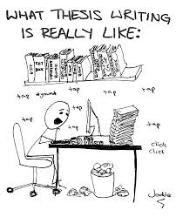
Writing a Thesis Statement: Literary Analysis
English 1

Slide 2
What is a thesis statement?
It is an arguable statement.
It is a complete sentence (or sentences) that expresses your position/opinion on a given topic.
It narrows down your topic to a specific focus of investigation.
It establishes a direction for the entire paper.
It is usually stated in your introduction.

Slide 3
What is not a thesis statement?
A thesis is never a question; it could be the answer to a question.
A thesis is not an announcement of purpose.
A thesis is not simply a topic.
A thesis is not a fact.

Slide 4
Writing a Thesis for a Literary Analysis Essay
A thesis has 2 parts:
“what”: answer to the main part of the prompt that answers the “what” question
“how”: show an understanding of the literary devices and/or elements of fiction the prompt asks you to analyze.
How do they function in connection with the answer to the “what” question
You will answer “why” in the body paragraphs

Slide 5
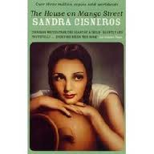
Break Down a Prompt” “What” and “How”
Prompt: Analyze Esperanza’s view of her family in “Hairs” by Sandra Cisneros. Focus on how the author uses syntax and figurative language to develop this character.
“What”: What is Esperanza’s view of her family?
“How”: How is syntax and figurative language used to develop Esperanza’s view of her family?

Slide 6
Determine whether the following is a good or poor thesis statement.
Does Esperanza dislike her family?
POOR
A thesis statement is not a question.

Slide 7
Determine whether the following is a good or poor thesis statement.
The purpose of my paper is to discuss Esperanza’s view of her family.
POOR
A thesis is not an announcement of purpose.

Slide 8
Determine whether the following is a good or poor thesis statement
Esperanza’s view of her family.
POOR
A thesis is not just a topic.

Slide 9
Determine whether the following is a good or poor thesis statement
Esperanza likes her family.
POOR
A thesis should not be this broad.

Slide 10
Determine whether the following is a good or poor thesis statement.
“What: In “Hairs” by Sandra Cisneros, Esperanza views her mother as the epitome of what it means to be home while the rest of the family seems secondary.
“How”: [*1]This view is conveyed through the author’s shift in syntax from short sentences when discussing everyone except the mother to long sentences when focusing on her mother’s affection.
[*2]Furthermore, the author contrasts the abundance of similes used to express the love Esperanza feels for her mother with only one simile chosen to describe each family member to emphasize her mother’s importance.
GOOD

Slide 11
Now placed together:
In “Hairs” by Sandra Cisneros, Esperanza views her mother as the epitome of what it means to be home while the rest of the family seems secondary. This view is conveyed through the author’s shift in syntax from short sentences when discussing everyone except the mother to long sentences when focusing on her mother’s affection. Furthermore, the author contrasts the abundance of similes used to express the love Esperanza feels for her mother with only one simile chosen to describe each family member to emphasize her mother’s importance.

Slide 12
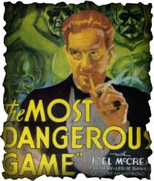
“The Most Dangerous Game” Essay Prompt
Prompt: Analyze the development of one theme in “The Most Dangerous Game” by Richard Connell through the story’s mood and character development.
“What”:
What is the theme?
“How”:
How is mood and character development used to develop this theme?

Slide 13
YOUR TURN!

Slide 14
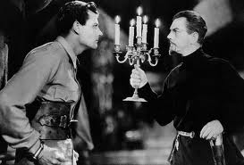
What + How
A theme in “The Most Dangerous Game” by Richard Connell is the idea that the deepest fear stems from uncertainty, and it is expressed through the development of mood and character. The fearful mood that dominates most of the hunt scenes stems from Rainsford’s uncertainty of Zaroff’s abilities. It is then that Rainsford’s terror is most intense and only subsides toward the resolution when he realizes that he must kill or be killed.

