Slide 1
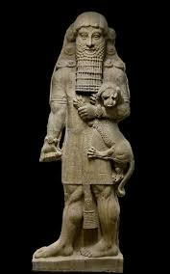
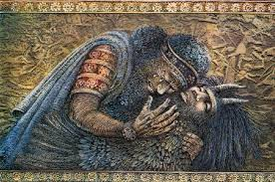
Gilgamesh Vocabulary Words
Week 1:
Gilgamesh Vocabulary Quiz 8/31

Slide 2
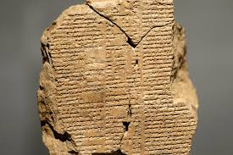
Quiz: Tablets I-IV: Friday 8/31
Understand the usage and definitions of all 12 words.
Be able to discuss characterization, plot points, and important events from Tablets
I-IV.
Know who is who:
Character matching

Slide 3
Tablets I-IV
1. Ignominy 7. Briar
2. Bitumen 8. Repose
3. Ashlar 9. Talons
4. Chaff 10. Scion
5. Delirium 11.Divination
6. Wroth 12. Ostentatious

Slide 4
Flashcards Due Tuesday 8/28
Front: Top right corner – initials
Word
Image
Part of Speech (adjective, adverb, noun ect.)
Back:
Definition
Synonym
Sentence using word

