Slide 1
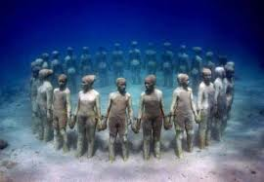
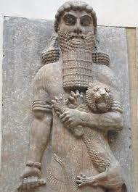
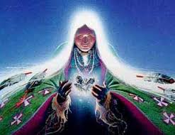
Creation Myths
Why do we study them?
Notes:
Maya – circle of people
Gilgamesh
Native American

Slide 2
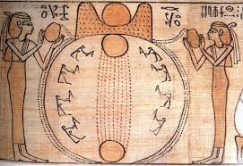
Creation stories and epics offer a unique window into the past.
They inform us as evidence
Make us wonder how important the stories were to the culture itself
They provoke questions:
Have the stories changed over time and translation?
What do these possible changes indicate?
What effect did an oral tradition have on their accuracy?

Slide 3
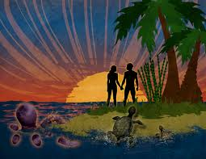
How do we judge their importance?
Do we base our judgment on what is important to us?
What if their religious beliefs, or cosmologies are not something we believe in - then what?
Should we look for ties between the past and the present? What would we gain with that understanding?
Notes:
Hawaiian

Slide 4
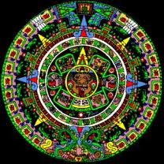
Creation Stories exist because:
They have helped to explain the universe
Developed a meaning for human existence
The stories often outlive the culture
Offer a basis for understanding the roles and rules of a civilization
Group identities, social relationships, definitions of ethics, gender roles, and class hierarchies

Slide 5
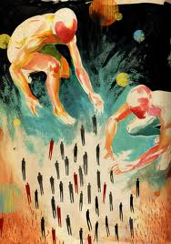
Where else do we unlock the key to earlier civilizations?
Scribed/Scripted ancient literature
Royal Decrees
Songs
Prayers and hymns
Guides for departing souls
Notes:
West African

Slide 6
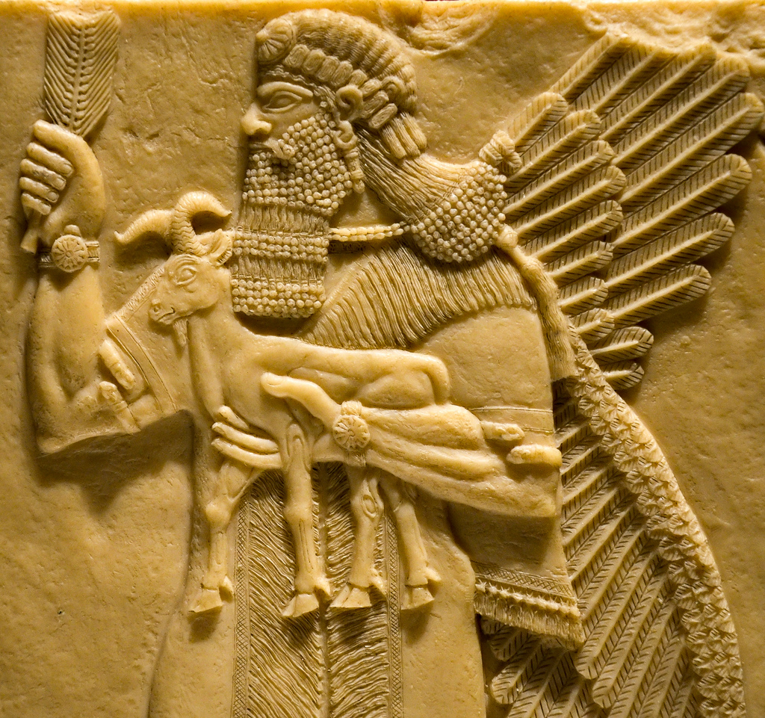
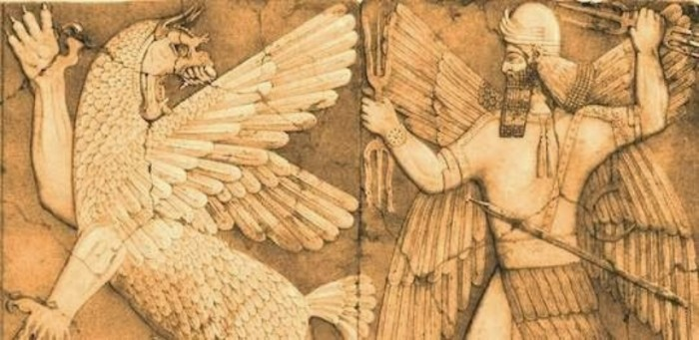
Let’s examine the story of Marduk

Slide 7
Marduk Jigsaw: Read the Introduction and prepare your presentation
A) Your table group will be assigned a paragraph to present to the class.
You will have 8-10 min to design your presentation of the Sumerian Myth.
You may draw, act out, or create a dramatization of your assigned paragraph.
Each member must contribute to interpretation

